Slide 1
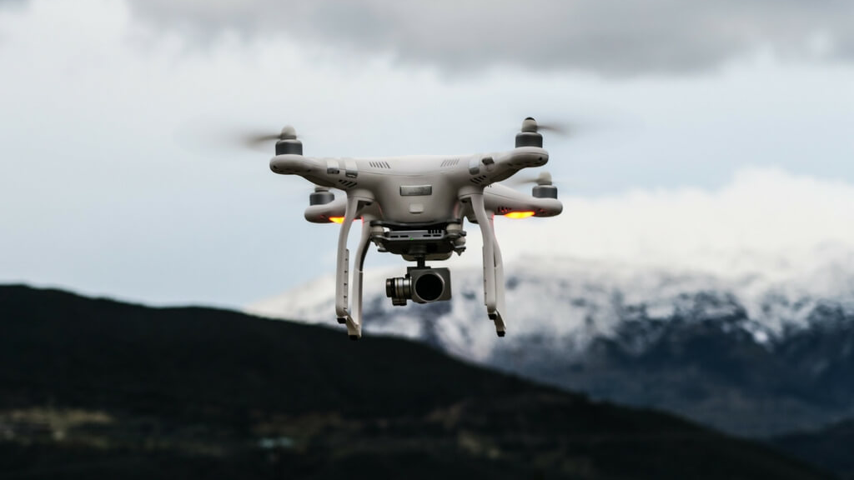
ROLE OF DRONES IN MODREN LIFE

Slide 2
INTRODUCTION
Drones – the Unmanned Aerial Vehicles (UAV’s) that were developed in the early 1917’s during World War 1(WW1) were a result of collaboration between the US Navy and inventors Elmer Sperry and Peter Hewitt.
Companies like DJI, Parrot, and Yuneec have revolutionized the drone industry popularizing them to a great extent.
The drone of the 21st century was ‘a flying robot that can be remotely controlled or fly autonomously autonomously through software-controlled flight plans in their embedded systems, working in conjunction with onboard sensors and GPS’.

Slide 3
HISTORY OF DRONES
EARLY DRONE TECHNOLOGY:
For long, Governments and Government supported organizations have used drones for reconnaissance, thermal imaging, remote sensing, and for agricultural purposes.
The earliest UAV in the history of drones was seen in 1839, when Austrian soldiers attacked the city of Venice with unmanned balloons filled with explosives.
MODERN HISTORY OF DRONES:
Their most well-known and controversial use is by the military for reconnaissance, surveillance and targeted attacks.

Slide 4
REQUIREMENT OF DRONES
Aerial photography and videography
Warfare and Border surveillance
Remote sensing
Telecommunication
Agriculture
Medicine
Weather forecasting

Slide 5
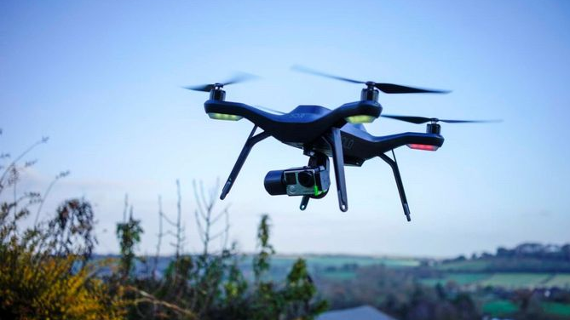
AERIAL PHOTOGRAPHY AND VIDEOGRAPHY

Slide 6
AERIAL PHOTOGRAPHY AND VIDEOGRAPHY
In 1858, Gaspar Felix Tournachon
(“Nadar,”).-the first successful aerial photograph
1
In 1860, James Wallace Black’s
Queen of the Air -the oldest surviving aerial photograph.
2
Later, George Lawrence strapped large-format cameras with curved film plates to kites.
3
In 1903, German engineer Alfred Maul demonstrated a gunpowder rocket.
4
That same year, Julius Neubronner, strapped cameras to his prescription-delivering pigeons
5
In 1903, The Wright Brothers’ first flight was first used for aerial imagery
6
In 1980s, The first modern-style drones appeared, as Israeli engineers developed drones with video cameras
7
Today’s store-bought drones are comparatively cheap, take high-quality images and video, and are easy to learn to fly.
8

Slide 7
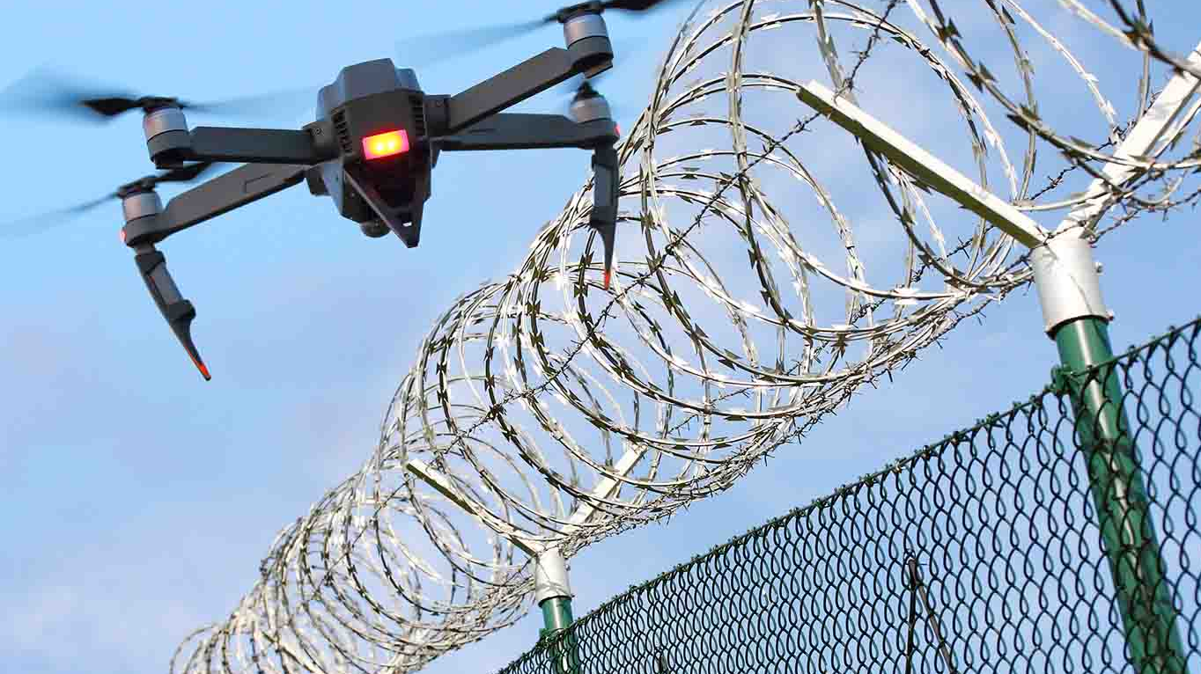
WARFARE
AND
BORDER SURVEILLANCE

Slide 8
WARFARE AND BORDER SURVEILLANCE
After the 9/11 terrorist attacks US invaded Afghanistan. It started all its operations using drones.
Drones of today have enormously improved and carry larger firepower and ammunition.
Easy manoeuvrability and higher altitudes are the reasons why they have been preferred so much.
What makes them lethal and effective for warfare are advancements in video-camera techniques, precision operations, stealth operations and faster speed.
Drones are used to monitor international borders and to prevent illegal migrants to cross borders.
Through a wireless network of sensors liked to drones governments are able to keep watch on borders.

Slide 9
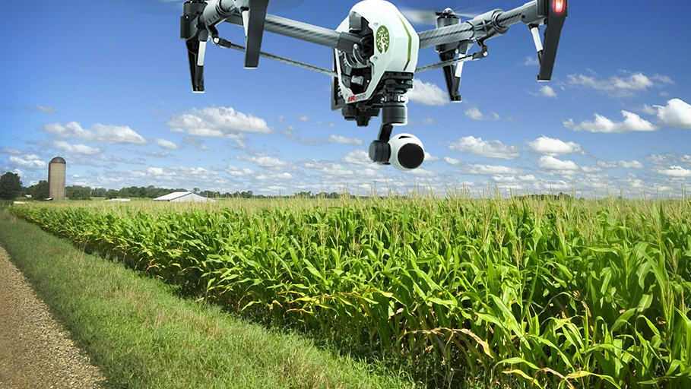
REMOTE SENSING

Slide 10

REMOTE SENSING
*Agricultural industry
Lidar is used to measure the height of crops by illuminating the crops with laser’s.
Heat sensors detect the temperature of livestock, the presence of water and their temperature.
This bird's-eye view can reveal many issues such as irrigation problems, soil variation, and pest and fungal infestations.
*Weather forecasting
The first successful weather satellite, the U.S. TIROS 1, launched in April 1960.
In 1991, NASA acquired the Perseus unmanned aircraft, one of the first advanced weather drone programs.
Drones will be fitted with a high-resolution camera enclosed in Kevlar material thus preventing damage to the systems.
*Environmental industry
Biological sensors that are used to check the quality of air
Fire department use drones to track wild fires

Slide 11
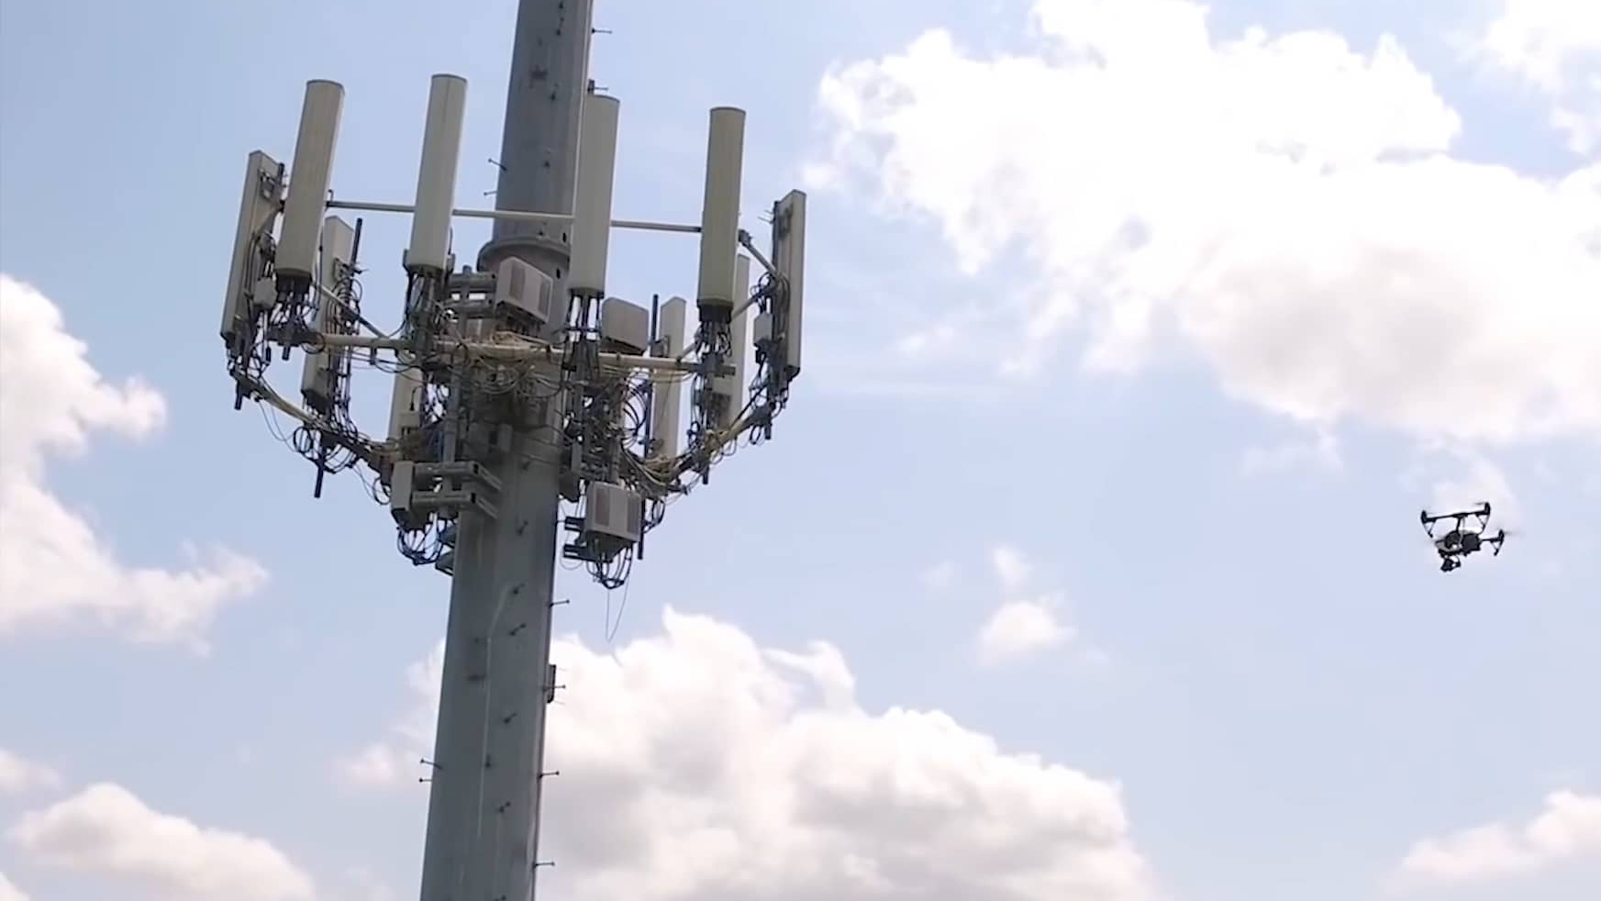
TELE-COMMUNICATION

Slide 12
TELE-COMMUNICATION
Tethered UAVs are powerful tools for telecommunications, acting as airborne relays. They enable the creation of temporary networks including: cellular, WiFi, high-frequency radio and 3G/4G signals.
Using drones for tower maintenance can help telecom operators cut expenses in more ways than one.
Drones can also be used for radio planning and line-of-sight testing, where line-of-sight refers to a clear path between two antennas.
AT&T describes as “flying COWS” (cells on wings), can be used to help boost signal strength in the short-term for areas impacted by a catastrophe.

Slide 13
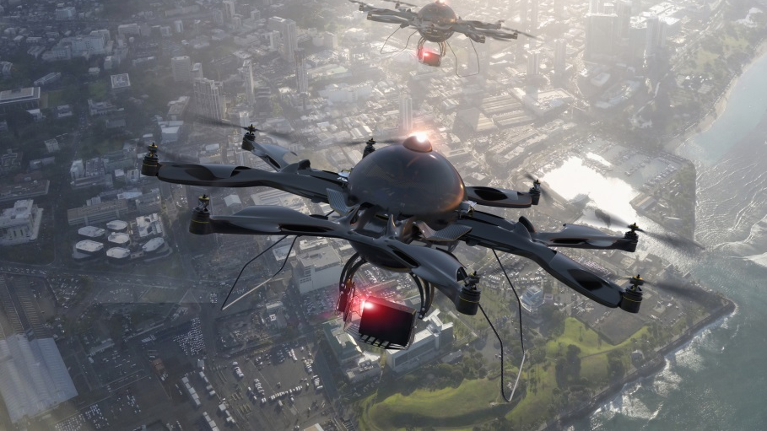
MEDICINE

Slide 15
FUTURE APPLICATIONS
APPLICATION OF DRONES IN “RETAIL”: In the era of Unmanned Aerial Vehicles (UAVs) the use of drones for delivery purpose will be the most commonly perceived application in future.
APPLICATION OF DRONES IN “INTERNET ACCESS”: Signal at remote areas by delivering 10gigabites of data per second over an area of 10 miles away.
APPLICATION OF DRONES IN “SECURITY”: One of the future - application of these drones is “SUNFLOWER LABS” in UK are developing drones for home security market.

Slide 16
CONCLUSION
In these rapidly changing times, we are not certain where the current rate at which technology is going to take us in the future. Utopia or Dystopia? We don’t know. As President John Fitzgerald Kennedy mentioned in his famous speech, “No man can fully grasp how far and how fast we have come…” . We must move forward with the current pace of development and must use these powers technology has given us in a wise way.
Drones are something that nearly everyone in the world has access to, but we must make sure that we do not use these for any activity that are legally and morally wrong.

